Slide 1

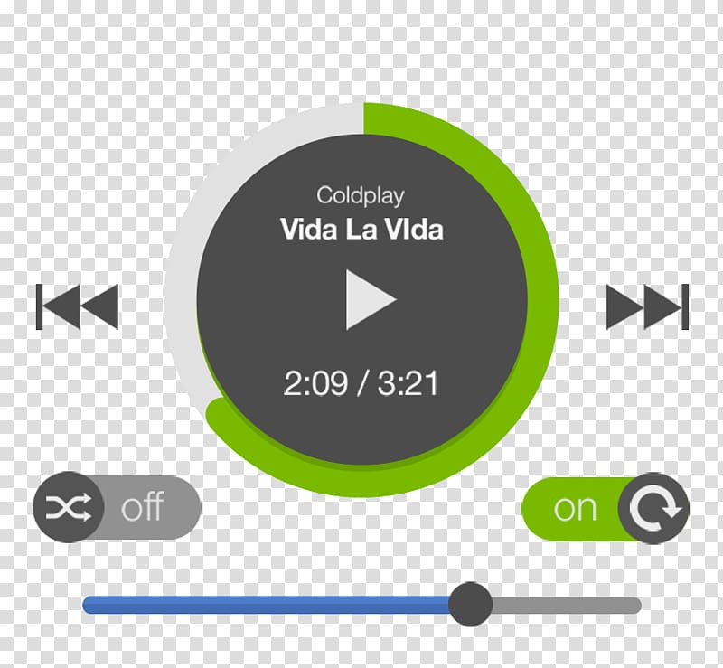
Get Your GUI On
“An MP3 to get you moving”
This MP3 Player will allow users to :
Play music and audio files on a simple, appealing, and functional interface
Experience an interface that displays the -title of the song or audio,
-the artist or creator,
-the duration of the file,
-the amount of audio played, and
-the amount that is left.
Dynamic Duo: Ambrielle August & Connor Rosenthal
GitHub Repository: https://github.com/aaugust98/MP3-Player-Project-

